Slide 1
Relational Algebra (Part-4)
20.3

Slide 2
Contents
Project
Selection + Projection

Slide 3
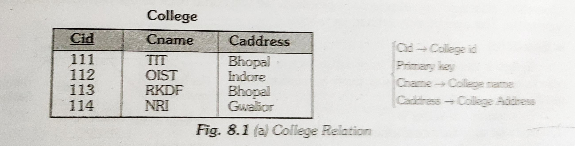
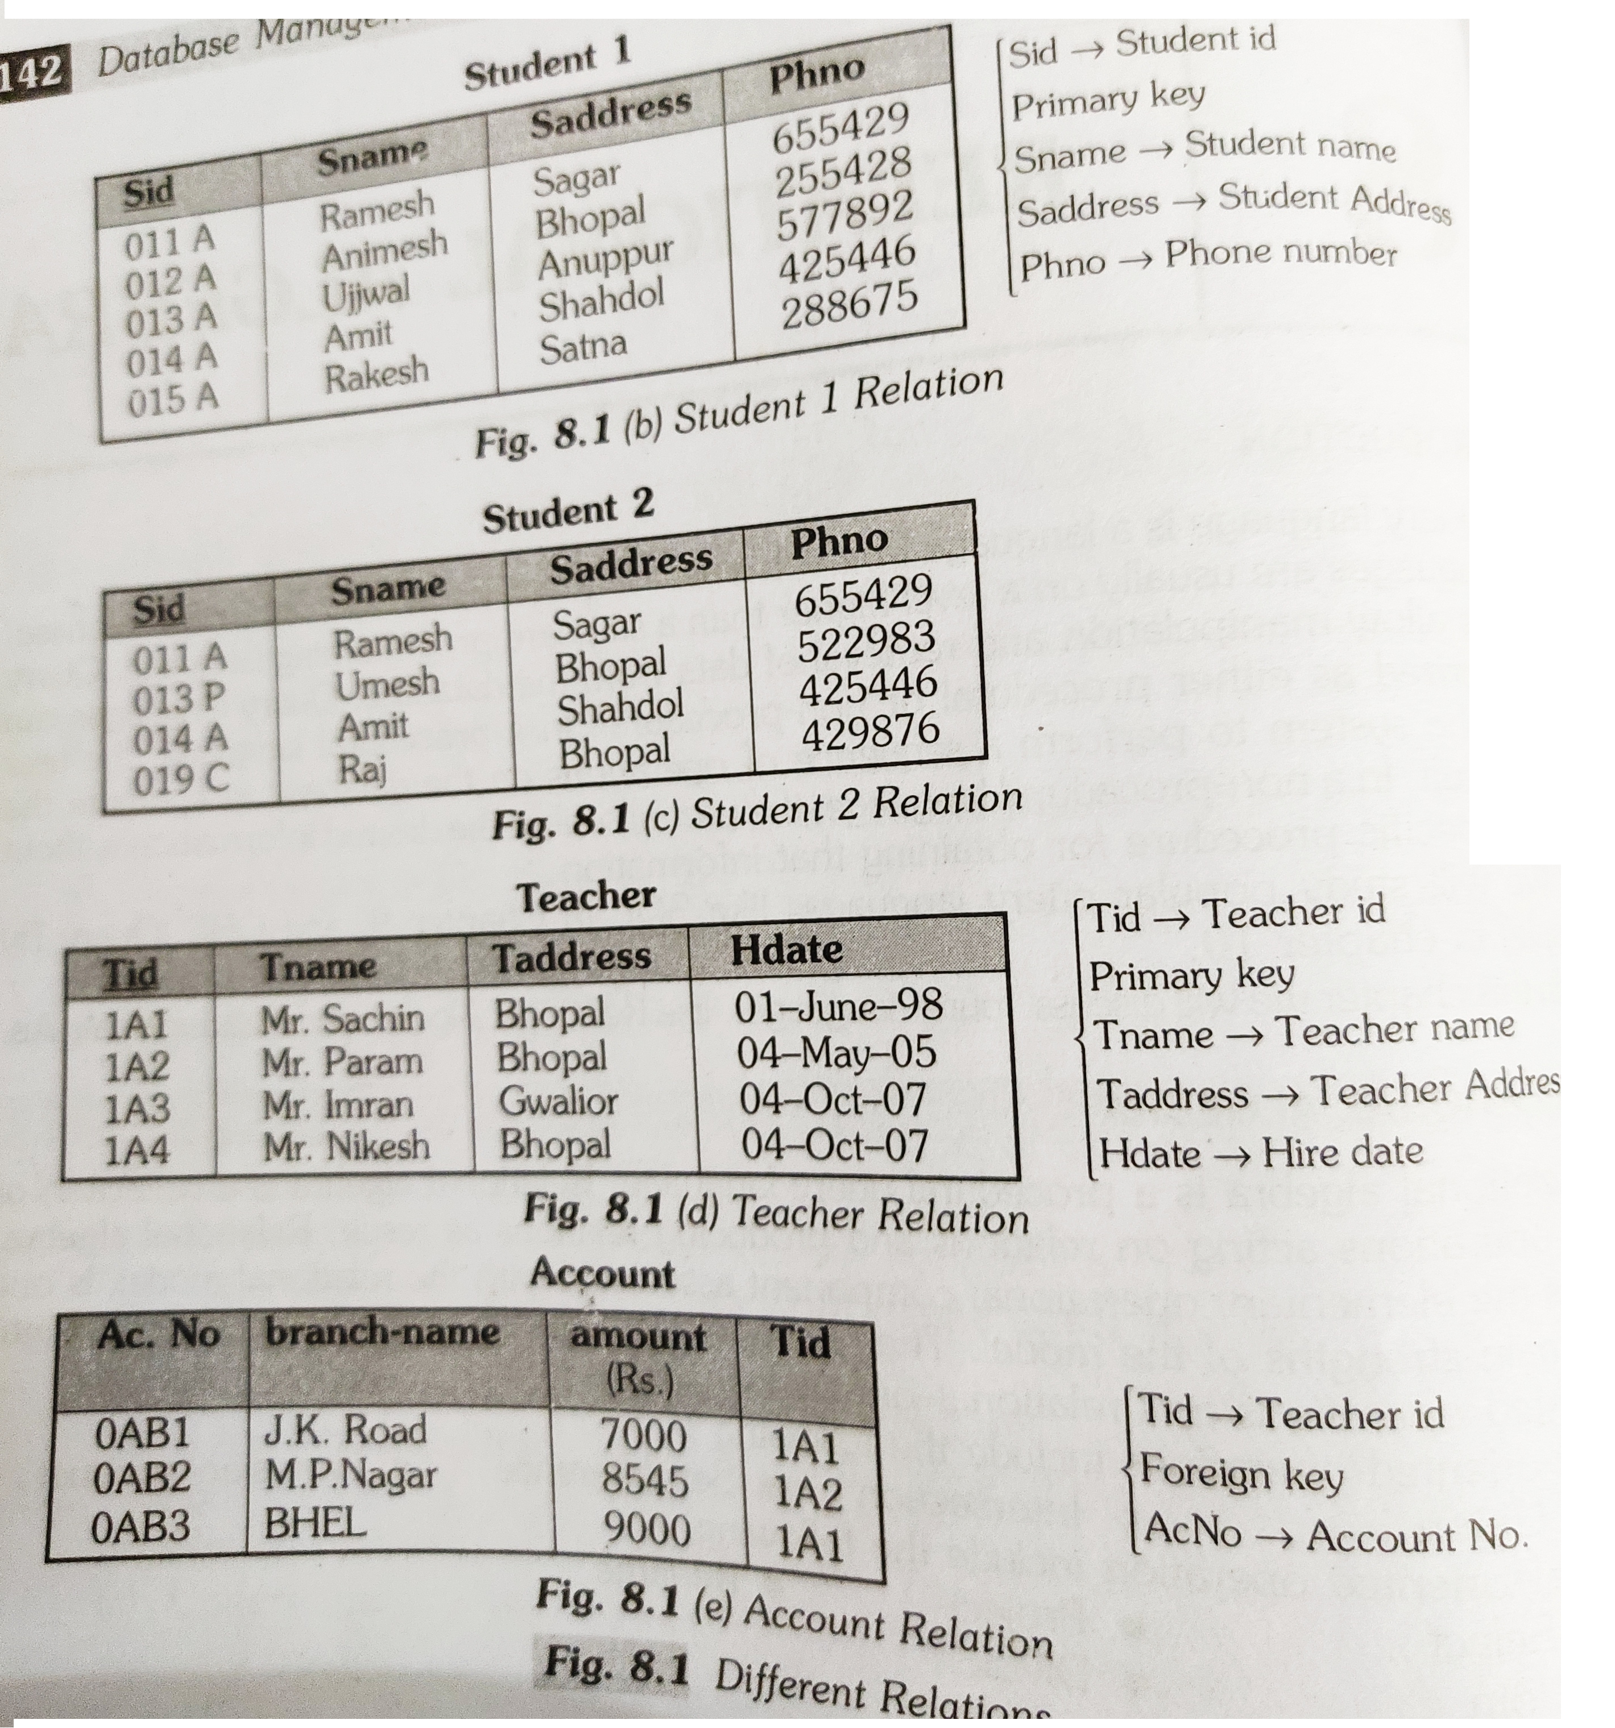
Select

Slide 4
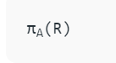
Project
Project operation selects (or chooses) certain attributes discarding other attributes. The Project operation is also known as vertical partitioning since it partitions the relation or table vertically discarding other columns or attributes.
where ‘A’ is the attribute list, it is the desired set of attributes from the attributes of relation(R),
symbol ‘π(pi)’ is used to denote the Project operator,
R is generally a relational algebra expression, which results in a relation.

Slide 5
Project

Slide 6
Select + Project

Slide 7


